Slide 1
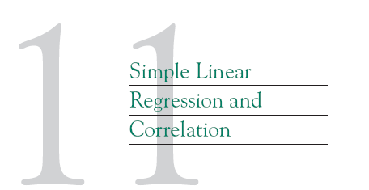

Slide 2
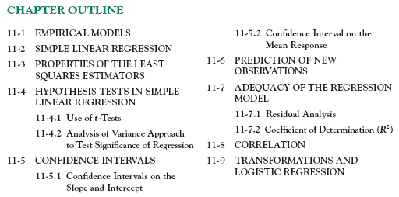

Slide 4

11-1 Empirical Models
Many problems in engineering and science involve exploring the relationships between two or more variables.
Regression analysis is a statistical technique that is very useful for these types of problems.
For example, in a chemical process, suppose that the yield of the product is related to the process-operating temperature.
Regression analysis can be used to build a model to predict yield at a given temperature level.

Slide 5













Slide 6
11-1 Empirical Models

Slide 7
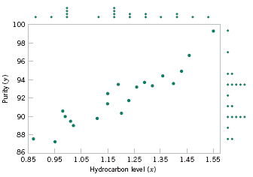

11-1 Empirical Models
Figure 11-1 Scatter Diagram of oxygen purity versus hydrocarbon level from Table 11-1.

Slide 8





11-1 Empirical Models
Based on the scatter diagram, it is probably reasonable to assume that the mean of the random variable Y is related to x by the following straight-line relationship:
where the slope and intercept of the line are called regression coefficients.
The simple linear regression model is given by
where ε is the random error term.

Slide 9



11-1 Empirical Models
We think of the regression model as an empirical model.
Suppose that the mean and variance of ε are 0 and σ², respectively, then
The variance of Y given x is

Slide 10
11-1 Empirical Models
The true regression model is a line of mean values:
where β₁ can be interpreted as the change in the mean of Y for a unit change in x.
Also, the variability of Y at a particular value of x is determined by the error variance, σ².
This implies there is a distribution of Y-values at each x and that the variance of this distribution is the same at each x.

Slide 11
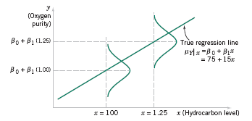
11-1 Empirical Models
Figure 11-2 The distribution of Y for a given value of x for the oxygen purity-hydrocarbon data.

Slide 12

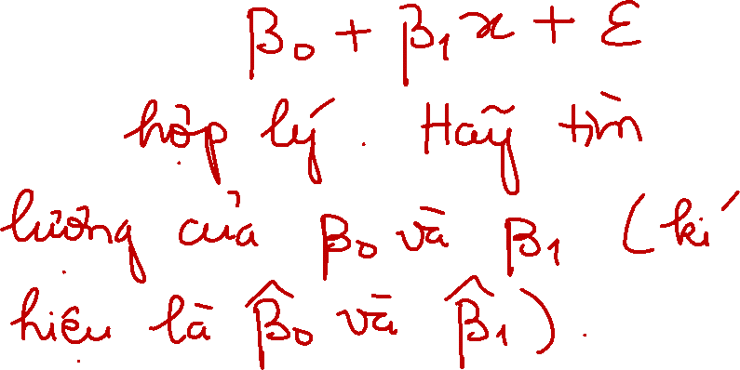














Slide 13
11-2 Simple Linear Regression
The case of simple linear regression considers a single regressor or predictor x and a dependent or response variable Y.
The expected value of Y at each level of x is a random variable:
We assume that each observation, Y, can be described by the model

Slide 14
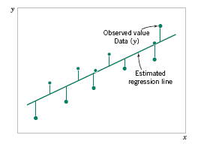
11-2 Simple Linear Regression
Suppose that we have n pairs of observations (x₁, y₁), (x₂, y₂), …, (x_{n}, y_{n}).
Figure 11-3 Deviations of the data from the estimated regression model.

Slide 15





11-2 Simple Linear Regression
The method of least squares is used to estimate the parameters, β₀ and β₁ by minimizing the sum of the squares of the vertical deviations in Figure 11-3.
Figure 11-3 Deviations of the data from the estimated regression model.

Slide 16





11-2 Simple Linear Regression
Using Equation 11-2, the n observations in the sample can be expressed as
The sum of the squares of the deviations of the observations from the true regression line is

Slide 17
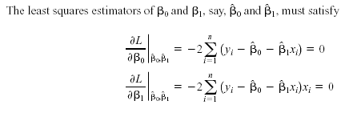








11-2 Simple Linear Regression

Slide 18
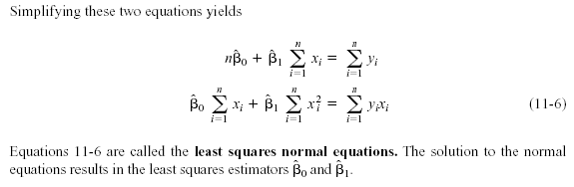
11-2 Simple Linear Regression

Slide 19
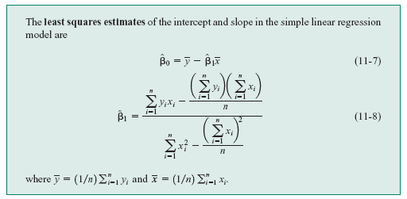
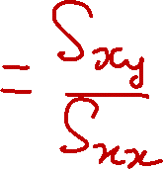







11-2 Simple Linear Regression
Definition

Slide 20


















Slide 21





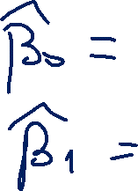










Slide 22
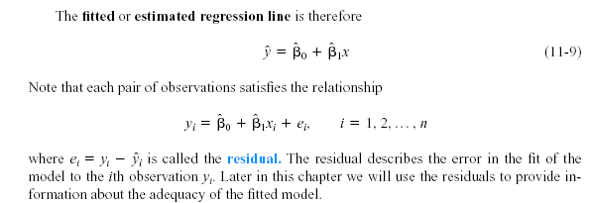
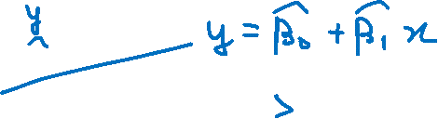


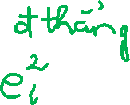



11-2 Simple Linear Regression

Slide 23




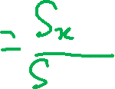





11-2 Simple Linear Regression
Notation

Slide 24
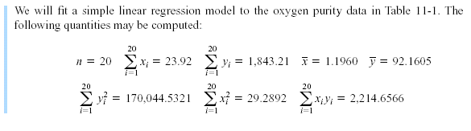
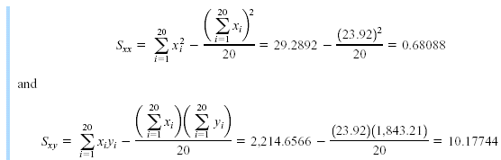
11-2 Simple Linear Regression
Example 11-1

Slide 25
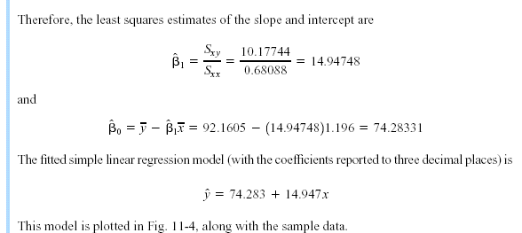
11-2 Simple Linear Regression
Example 11-1

Slide 26
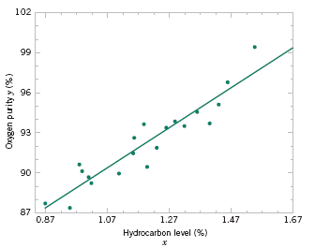
11-2 Simple Linear Regression
Example 11-1
Figure 11-4 Scatter plot of oxygen purity y versus hydrocarbon level x and regression model ŷ = 74.20 + 14.97x.

Slide 27

11-2 Simple Linear Regression
Example 11-1

Slide 28



Slide 29


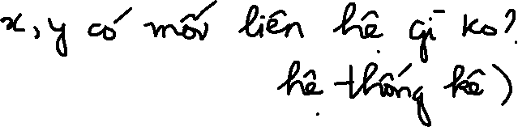




















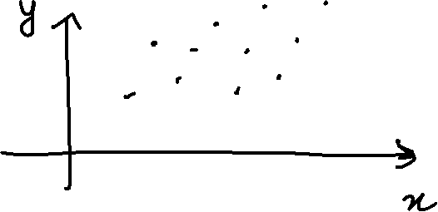


Slide 30


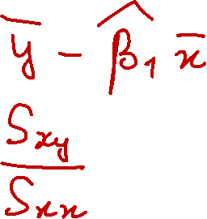



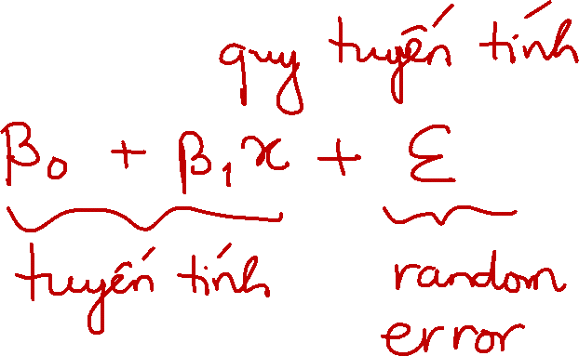





Slide 31















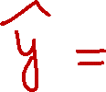











Slide 32


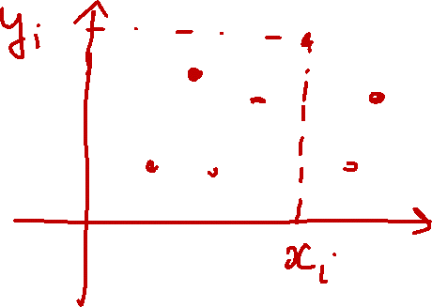















Slide 33













Slide 34
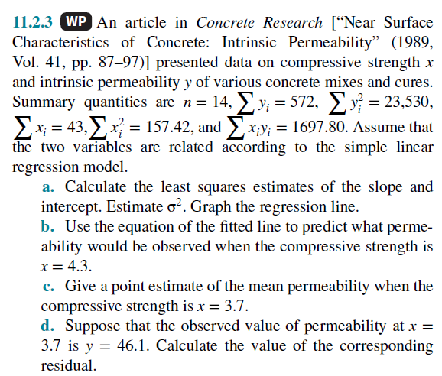

Slide 35

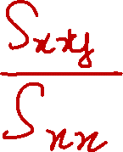
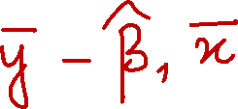


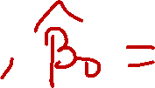



Slide 36



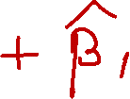
















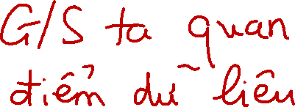



Slide 37
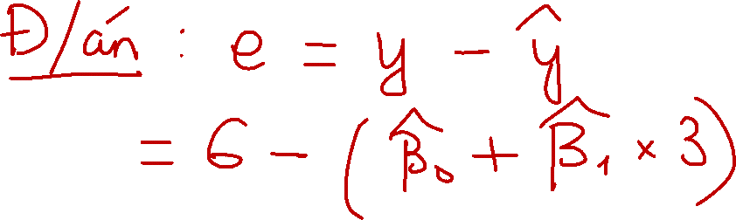

Slide 38




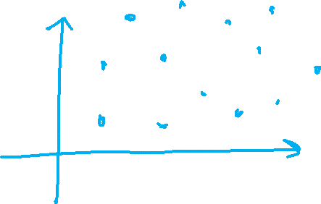









Slide 39
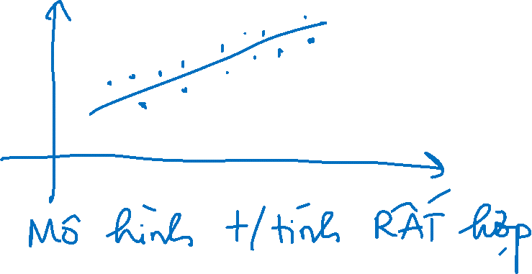
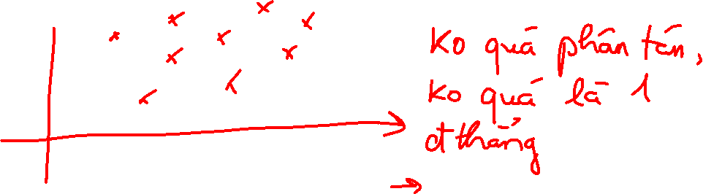




Slide 40







11-2 Simple Linear Regression
Estimating σ²
The error sum of squares is
It can be shown that the expected value of the error sum of squares is E(SS_{E}) = (n – 2)σ².

Slide 41











11-2 Simple Linear Regression
Estimating σ²
An unbiased estimator of σ² is
where SS_{E} can be easily computed using

Slide 42





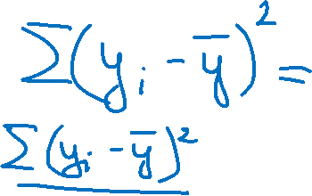




Slide 43











Slide 44



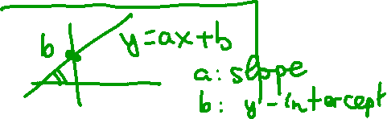







11-3 Properties of the Least Squares Estimators
Slope Properties
Intercept Properties

Slide 45


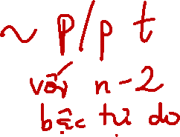

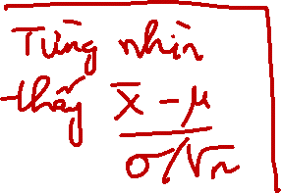

11-4 Hypothesis Tests in Simple Linear Regression
11-4.1 Use of t-Tests
Suppose we wish to test
An appropriate test statistic would be

Slide 46


11-4 Hypothesis Tests in Simple Linear Regression
11-4.1 Use of t-Tests
The test statistic could also be written as:
We would reject the null hypothesis if

Slide 47




11-4 Hypothesis Tests in Simple Linear Regression
11-4.1 Use of t-Tests
Suppose we wish to test
An appropriate test statistic would be

Slide 48
11-4 Hypothesis Tests in Simple Linear Regression
11-4.1 Use of t-Tests
We would reject the null hypothesis if

Slide 49






11-4 Hypothesis Tests in Simple Linear Regression
11-4.1 Use of t-Tests
An important special case of the hypotheses of Equation 11-18 is
These hypotheses relate to the significance of regression.
Failure to reject H₀ is equivalent to concluding that there is no linear relationship between x and Y.

Slide 50
11-4 Hypothesis Tests in Simple Linear Regression
Figure 11-5 The hypothesis H₀: β₁ = 0 is not rejected.

Slide 51
11-4 Hypothesis Tests in Simple Linear Regression
Figure 11-6 The hypothesis H₀: β₁ = 0 is rejected.

Slide 52










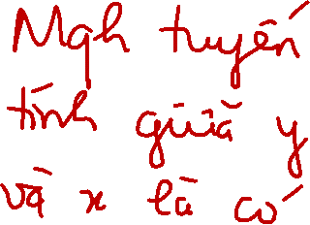





Slide 53
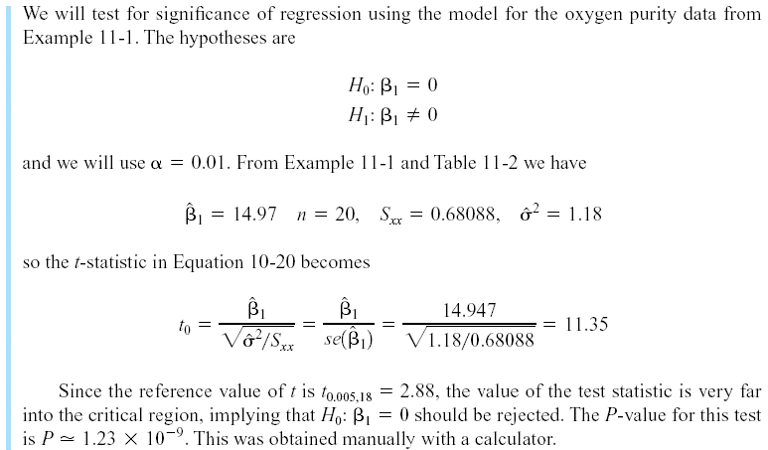
11-4 Hypothesis Tests in Simple Linear Regression
Example 11-2

Slide 54
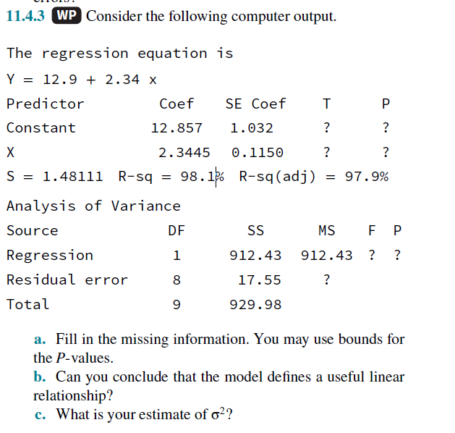

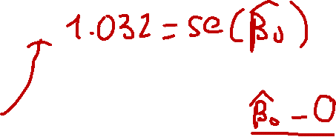
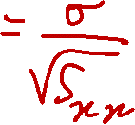






Slide 55

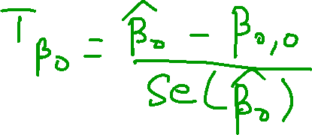





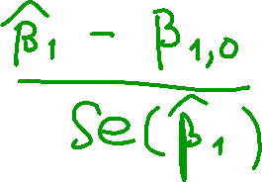

Slide 56











11-4 Hypothesis Tests in Simple Linear Regression
11-4.2 Analysis of Variance Approach to Test Significance of Regression
The analysis of variance identity is
Symbolically,

Slide 57
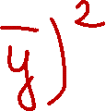





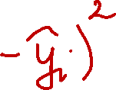





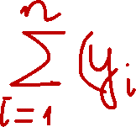

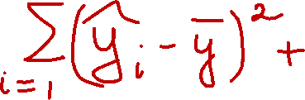





Slide 58


























Slide 59











Slide 60










Slide 61




11-4 Hypothesis Tests in Simple Linear Regression
11-4.2 Analysis of Variance Approach to Test Significance of Regression
If the null hypothesis, H₀: β₁ = 0 is true, the statistic
follows the F_{1,n-2} distribution and we would reject if f₀ > f_{α,1,n-2}.

Slide 62

11-4 Hypothesis Tests in Simple Linear Regression
11-4.2 Analysis of Variance Approach to Test Significance of Regression
The quantities, MS_{R} and MS_{E} are called mean squares.
Analysis of variance table:

Slide 63

11-4 Hypothesis Tests in Simple Linear Regression
Example 11-3

Slide 64




11-4 Hypothesis Tests in Simple Linear Regression

Slide 65















Slide 66











11-8 Correlation

Slide 67















Slide 68


Slide 69







11-8 Correlation
We may also write:

Slide 70









Slide 71


11-8 Correlation
It is often useful to test the hypotheses
The appropriate test statistic for these hypotheses is
Reject H₀ if |t₀| > t_{α/2,n-2}.

Slide 72


11-8 Correlation
The test procedure for the hypothesis
where ρ₀ ≠ 0 is somewhat more complicated. In this case, the appropriate test statistic is
Reject H₀ if |z₀| > z_{α/2}.

Slide 73

11-8 Correlation
The approximate 100(1- α)% confidence interval is

Slide 74












Slide 75











Slide 76









Slide 77



















Slide 78






















Slide 79















Slide 80

11-8 Correlation
Example 11-8

Slide 81
11-8 Correlation
Figure 11-13 Scatter plot of wire bond strength versus wire length, Example 11-8.

Slide 82
11-8 Correlation
Minitab Output for Example 11-8

Slide 83

11-8 Correlation
Example 11-8 (continued)

Slide 84


11-8 Correlation
Example 11-8 (continued)

Slide 85

11-8 Correlation
Example 11-8 (continued)

